Slide 1

Emerging Technology Skills and Trends Annual Report
Prepared by: Christopher Petty
Date: July 14th, 2025

Slide 2

Table of Contents
Executive Summary
Introduction
Methodology
Results
Visualization – Charts
Dashboard
Discussion
Findings & Implications
Conclusion
Appendix

Slide 3

EXECUTIVE SUMMARY
As a global leader in the IT and business consulting industry, our firm has initiated an annual analysis to identify emerging and future in-demand tech skills in response to the fast-paced technology landscape, to ensure that an organization can complete in the ever-changing technological landscape.
This year's analysis sought to uncover the most sought-after programming languages, database technologies, and other technologies, using various sources that are publicly available, IBM’s internal databases, a Stack overflow survey, and job postings. The data was collected, cleaned, subjected to exploratory analysis and visualized on the report's dashboards.
The findings illustrate the strong current usage of JavaScript, and while Python is becoming more popular, the outlook shows that JavaScript will remain the language of choice in the future. Postgre SQL is the industry standard and looks to remain that way as we move into the future as the top database utilized around the world, but there has been an increased interest in other options like SQL Light.

Slide 4

INTRODUCTION
This report utilizes multiple data analytics tools to understand and highlight the knowledge and skills that organizations will require relating to programming languages, databases, web frames, and platforms, and has a proposed target audience of:
Executive Leadership & Strategy Teams
Talent Acquisition & Human Resources
Learning & Development (L&D) Departments
Technical Delivery Managers & Practice Leads
Clients & Partners
The analysis aims to answer critical questions such as:
What programming languages are most in demand in 2025?
Which database technologies are currently preferred?
Which IDEs are most frequently used by developers?
What tare the target demographics of the individuals utilizing the technology?

Slide 5





METHODOLOGY
Data Collection
Data Wrangling
Exploratory Analysis
Visualization and Insights
Primary Sources:
Stack Overflow Developer Survey 2024: used as a benchmark dataset representing global developer trends.
Skills Network (IBM): scraped from reputable employment platforms to assess real-time demand for technical skills.
Standardized column names and data formats across sources, and handled missing values, duplicates, and outliers
Transformed categorical variables (e.g., programming languages, tools) into consistent taxonomies
Merged datasets using common fields for unified analysis
Used Python libraries such as pandas, NumPy, and matplotlib/seaborn for initial analysis
Applied statistical techniques to identify frequency and ranking of languages, tools, and technologies
Measured correlation between job demand and survey popularity
Built interactive dashboards in IBM Cognos Analytics to present:
Top programming languages and databases by demand
Emerging vs. declining technologies
IDE preferences across user groups
Dashboards enabled drill-down capabilities by region, job type, and experience level

Slide 6
RESULTS
After conducting extensive data collection, cleaning, and analysis, the results reveal clear patterns in the current demand for programming skills, database technologies, and development tools across the tech industry. The integrated dataset highlights both consistent trends and emerging shifts in the global developer landscape. The following findings present a data-driven view of which technologies are leading the market, which skills are gaining traction, and how these trends align with industry training and hiring behavior. These insights provide valuable guidance for workforce planning, curriculum development, and strategic consulting.

Slide 7
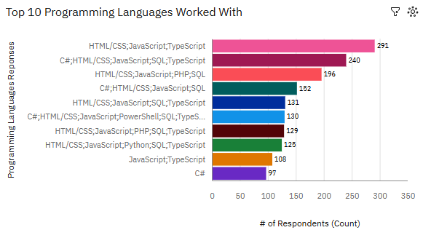
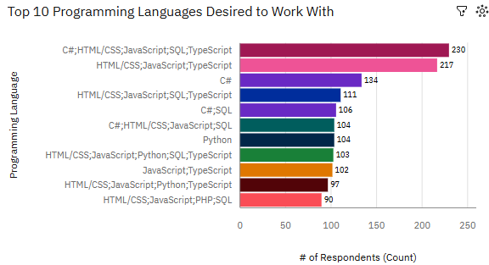
PROGRAMMING LANGUAGE TRENDS
Current Year
Next Year

Slide 8
PROGRAMMING TRENDS
FINDINGS & IMPLICATIONS
Findings
Implications
Respondents overwhelmingly utilize multiple programming languages and are not dedicated to one or the other.
JavaScript, TypeScript, HTML/CSS, and C+ are currently the most accepted programming languages, with outlook for the future remaining the same.
The future outlook illustrated that Python and SQL are gaining traction and are projected continue a steady increase of usage due to the changing technological environment.
The top use-case for JavaScript and HTML is web-development and the industry is proficient in these areas, and the demand continues to grow into the future.
Python is seeing increased acceptance and usage, primarily due to the increased demand for Artificial Intelligence and Machine Learning, as well as it improve ease of use over legacy languages.
Data professionals look to SQL as the industry leading language, due to ease of use and integration with Python.

Slide 9
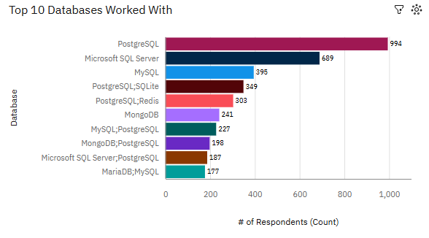
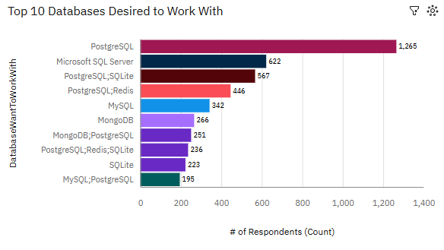
DATABASE TRENDS
Current Year
Next Year

Slide 10
DATABASE TRENDS FINDINGS & IMPLICATIONS
Findings
Implications
Postgre SQL, MicrosoftSQL Server, and MySQL are currently the top 3 most-used databases.
SQLite is projected to grow in usage and acceptance, as it seamlessly works within the Python language.
MariaDB is projected to lose its share of usage to the increased usage of SQL, Redis, and Mongo.
While in different forms and structures, SQL is still the go-to tool for IT industry professionals, specifically within data specializations.
The popularity of Postgre SQL among developers will drive growth in popularity as more management and team members utilize more, due to the ability to handle multiple data types are sources.
Open-source databases offer more flexibility and adaptability hence the linear and correlated growth between Python usage and Postgre SQL

Slide 11
PLATFORMS & WEBFRAMES FINDINGS & IMPLICATIONS
Findings
Implications
Amazon Web Service (AWS) and Microsoft Azure have a massive footprint and are the overwhelmingly preferred platform by developers.
Spring Boot is the leading web-frame utilized, with React and Node.js coming in just behind them.
Developers are looking towards new solutions for platforms, as Digital Ocean, Hetzner, and Cloudfare have become popular choices that developers are beginning to work with.
As acceptance and use of new languages and databases are increasing, it is leading to new IDE platforms and web-frames that align with the ease of use and customization.
New platforms like Cloudfare will continue to see a shift from traditional databases, and shift to the newer versions like SQLite and MongoDB

Slide 12

DASHBOARD
The following slides show the different tabs of the IBM COGNOS Dashboard.
The link to the IBM Cognos dashboard is as follows:
https://github.com/Cpetty1014/IBM-Data-Analysist-Capstone-Project/blob/17606392b1bb2f441b2296375df7f2a2b76dc66f/Capstone%20Dashboard.pdf
IBM COGNOS DASHBOARD

Slide 13
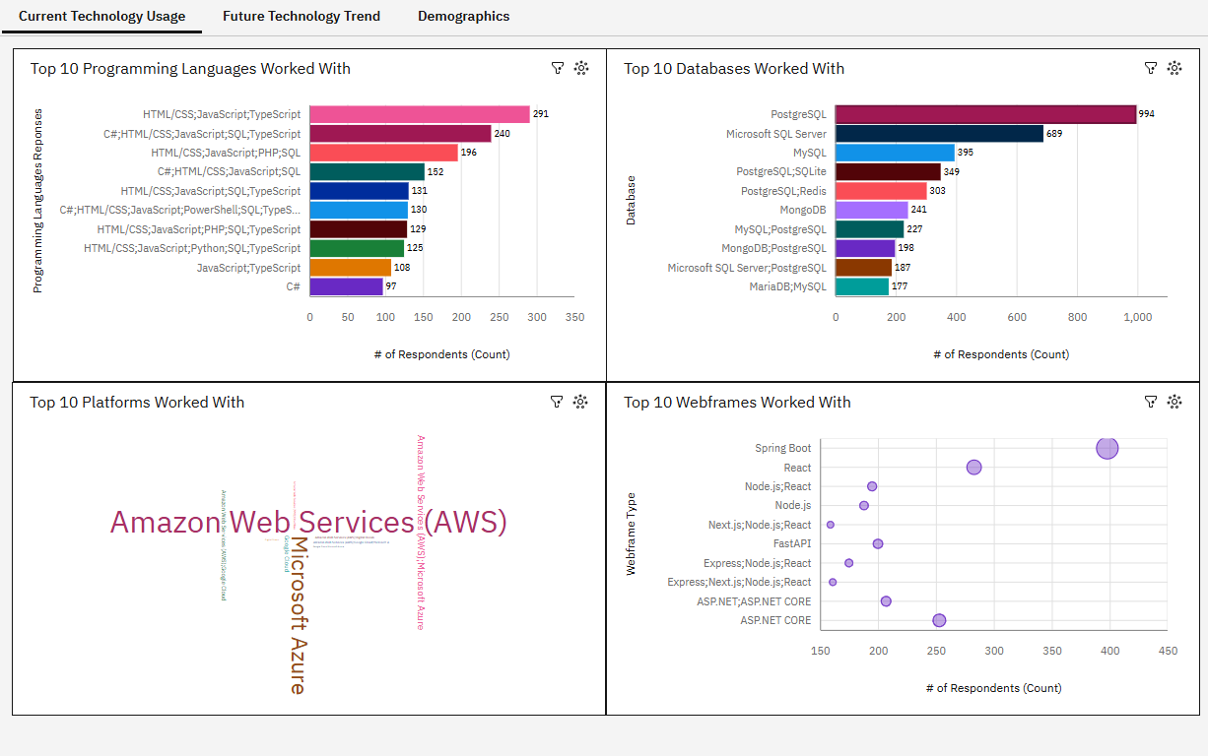
DASHBOARD TAB 1

Slide 14
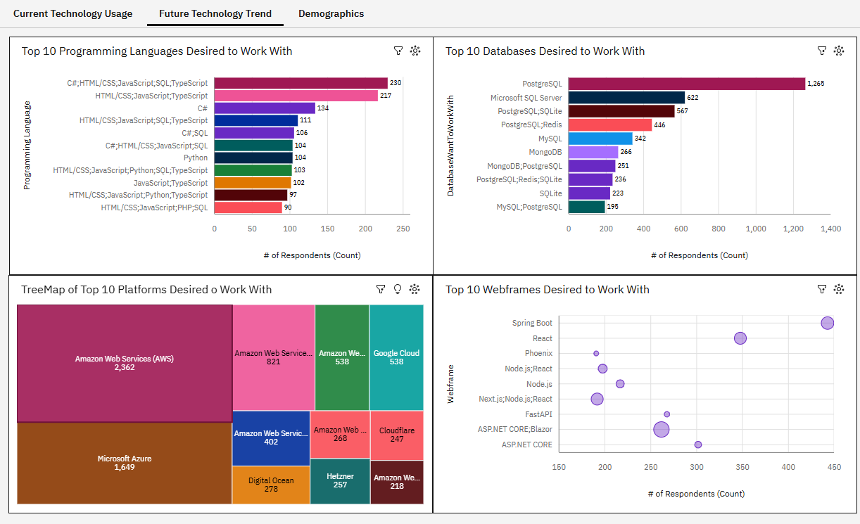
DASHBOARD TAB 2

Slide 15
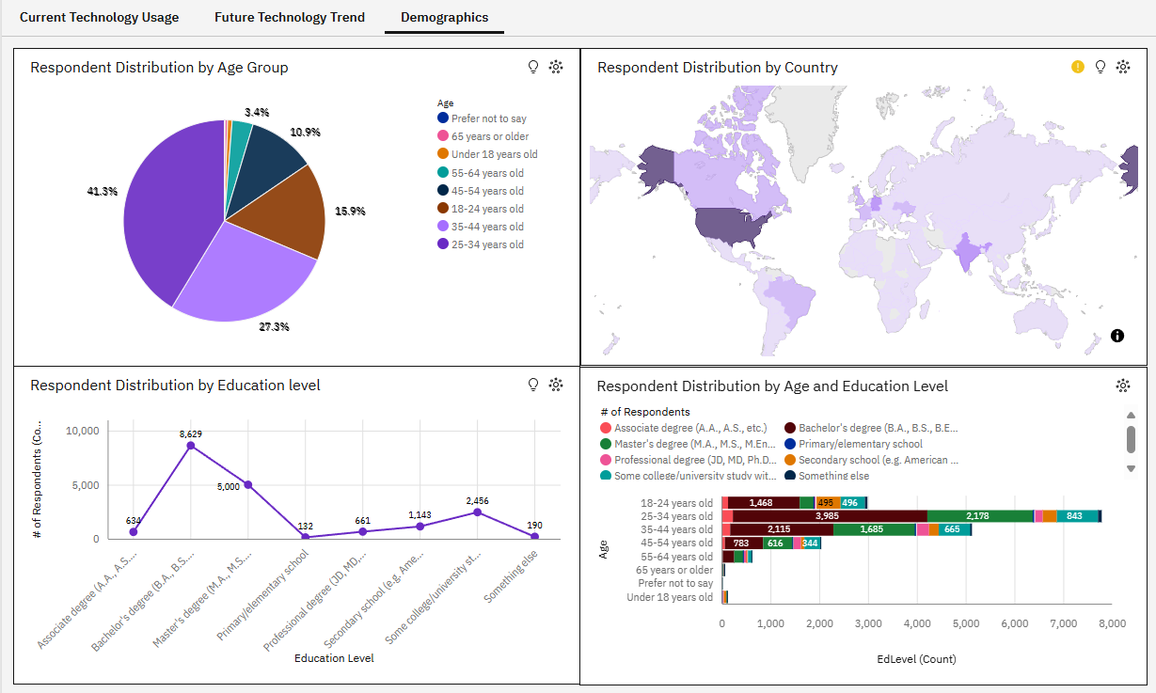
DASHBOARD TAB 3

Slide 16

DASHBOARD INSIGHTS
As the younger generation continues to enter the IT and data industry, the more diverse the tool usage will be throughout the industry. More flexible languages like Python have ignited innovation and change within the legacy market.
Experience within the data science field does not directly correlate with education, opening a question of whether or not it is necessary to be successful.
More tech education, access to the internet and hardware, is driving increased IT knowledge within developing nations.
Skilled talent within the tech sector is necessary as more products, services, and requirements from organizations continue to exponentially evolve.

Slide 17
OVERALL FINDINGS & IMPLICATIONS
Findings
Implications
The largest portion of developers in the IT field have a Bachelor’s Degree.
The IT and tech sectors are predominantly comprised of people that fall under the age of 44.
People want to learn the newer languages such as Python, or the more robust and flexible database and platforms like PostgreSQL.
SQL knowledge and understanding is required for data professionals who want to be successful within the industry.
Web-development is the most saturated segment of the industry but is also on of the most demanded due to the rise of social media advertising which requires constant adaptation to ensure messaging.
Developmental status of a country dramatically impacts the nations educational competency in the tech field, and more time and resources are needed to involved more of the global population.

Slide 18

CONCLUSION
The development of Artificial Intelligence and Machine-Learning has increased the need for data professionals who can properly collect, processes and then analyze large data sets.
With the rise of new languages and platforms being utilized throughout the industry, the most prominent data professionals will be required to self-educate and adapt, as to stay relevant within an industry with such an innovation curve.
Job listings for data professionals is at an all time high, as every organization is grappling with the rise of Artificial Intelligence as a Business Intelligence tool, and scrambling to understand the most efficient uses-cases, while also incurring the ethical questions of how it ‘should’ be utilized.
While new technology has continued to be available to data professionals, SQL, JavaScript and HTML are legacy tools that most others have been built upon, and a base knowledge of each is the foundational platform for data science.

Slide 19

APPENDIX
Include any relevant additional charts, or tables that you may have created during the analysis phase.

Slide 20
JOB POSTINGS

Slide 21
POPULAR LANGUAGES

